Slide 1

MOSQUITO APPLICATION
Mosquito Application
Innovative Solutions for Mosquito Managemen
Subtitle: Innovative Solutions for Mosquito Management
Your Name/Company Nam
Date

Slide 2
Introduction
Why Mosquito Control Matters .
Mosquitoes: A Persistent Problem
Disease Transmission
Malaria: Caused by Plasmodium parasites transmitted through Anopheles mosquitoes. Affects millions globally, with symptoms including fever, chills, and flu-like illness.
Dengue Fever: Transmitted by Aedes mosquitoes. Characterized by high fever, severe headache, pain behind the eyes, joint and muscle pain, rash, and bleeding.
Zika Virus: Also spread by Aedes mosquitoes. Often asymptomatic but can cause birth defects if contracted during pregnancy, including microcephaly.
West Nile Virus: Spread by Culex mosquitoes. Can lead to neurological symptoms such as meningitis or encephalitis.
Chikungunya: Caused by Chikungunya virus, transmitted by Aedes mosquitoes. Symptoms include fever, joint pain, and rash.

Slide 3
What is the Mosquito application?
MosquitoGuard is an innovative mobile application designed to help you stay safe and comfortable by providing real-time mosquito activity tracking, personalized prevention tips, and disease risk alerts. By leveraging advanced technology and community data, MosquitoGuard offers proactive solutions to reduce mosquito bites and the spread of mosquito-borne diseases. Easily monitor mosquito activity in your area, receive timely updates, and access expert advice to protect yourself and your loved ones from the nuisances and health risks associated with mosquitoes.

Slide 4
Features
1.Real-Time Mosquito Activity Mapping
2. Personalized Prevention Tips
3. Personalized Prevention Tips
4. Community Reports and Updates

Slide 5
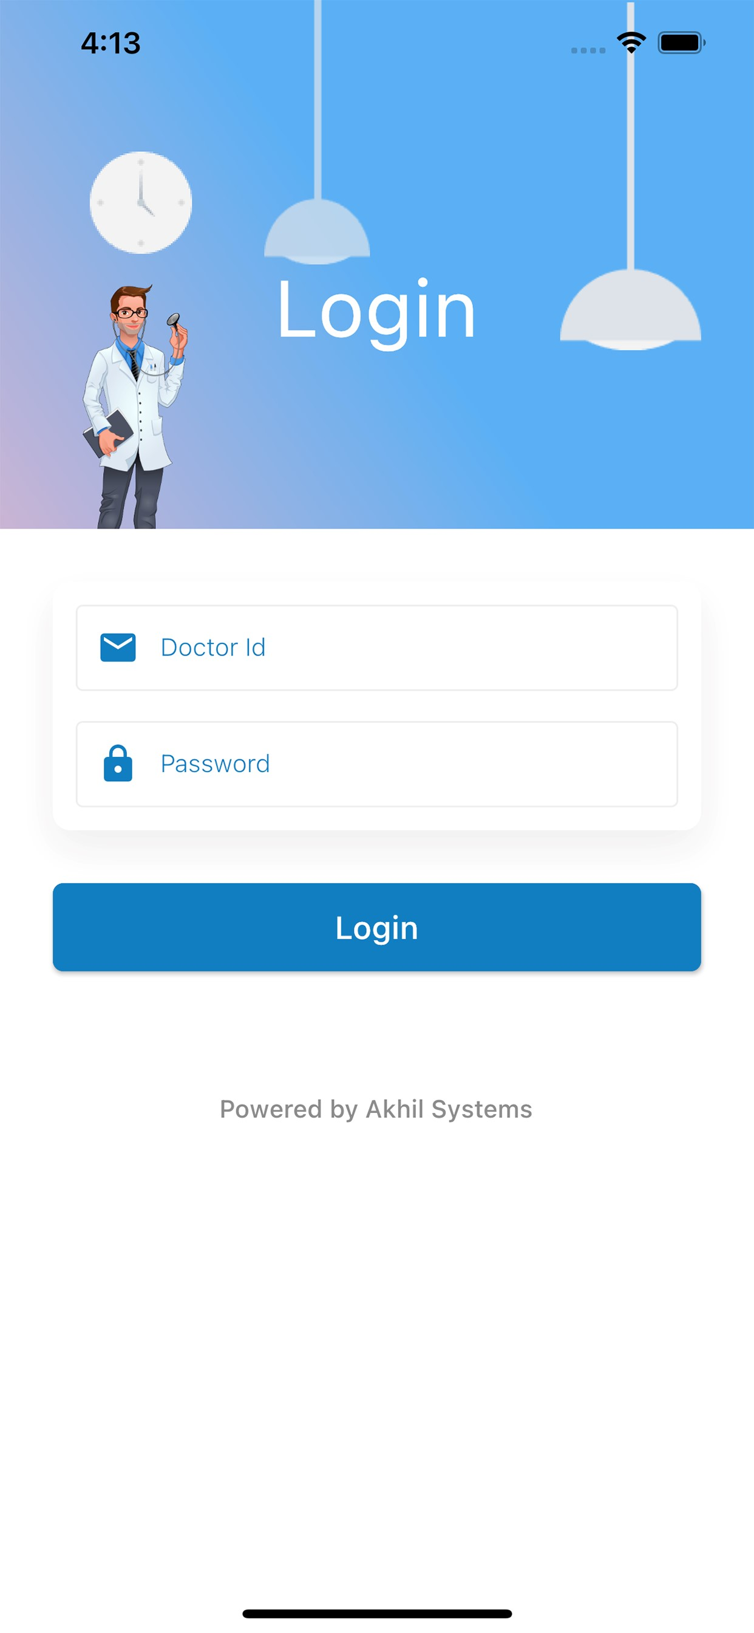

Slide 6
